Slide 1
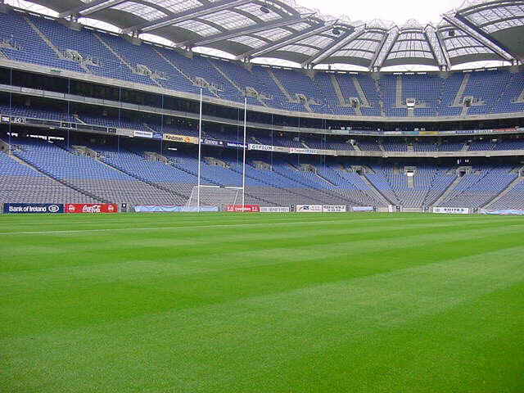
Tobacco- free GAA Clubs
Going Tobacco-free
A New Opportunity for GAA Clubs

Slide 2
Tobacco- free GAA Clubs Tobacco use – is it a problem?
1 in every 2 smokers will be killed by their smoking
5,200 in Ireland annually
Half of them will die prematurely (before 70 yrs)
Most smokers lose 10-15 years of quality life
No safe level of exposure to second- hand smoke (SHS)
Significant environmental hazard

Slide 3
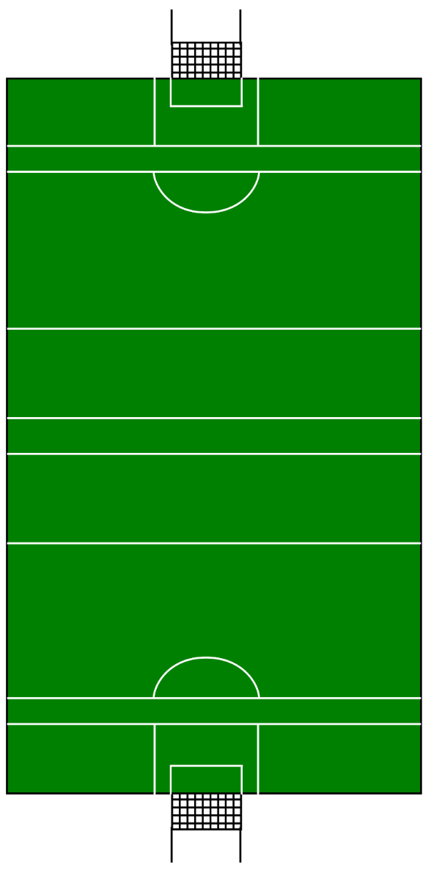
100 Member Club
How healthy is your membership?

Slide 4
19 are smokers

Slide 5
Half of those will die from smoking related conditions

Slide 6
Tobacco- free GAA Clubs
Why?
Set a positive example
De-normalising any association between GAA & tobacco usage
Children learn about smoking from adults, break the cycle
Reducing the initiation of smoking amongst young people

Slide 7
Tobacco- free GAA Clubs?
Why?
Protect members, volunteers & visitors from immediate dangers of tobacco & SHS exposure
Protecting non- smokers from SHS exposure
Reduce the impact of tobacco & SHS on sports performance
Safer & more comfortable GAA grounds
Minimise tobacco- related litter

Slide 8
Tobacco-free GAA Clubs
Plan
Step 1 Request a meeting with Club Executive to get them on board
Step 2 Set out the case for going smoke-free to include health and environmental benefits (include e- cigarettes)
Step 3 Reinforce the success of St. Johns Volunteers, Wexford who went tobacco-free during phase 1 of HC project & other stadiums/universities going tobacco- free

Slide 9
Plan
Step 4 Sign off on the GAA Tobacco- Free Policy
Step 5 Set a date for going tobacco-free.
Step 6 Communicate this decision widely to include all involved.

Slide 10
Tobacco-free GAA Clubs
Zero Tolerance
It is well established that the best outcomes emerge from a zero tolerance policy both in regard to going tobacco-free and staying tobacco-free.
Consider banning smoking in the entire geographical area to include sports fields and facilities, irrespective of how large the overall facility is.

Slide 11
Tobacco-free GAA Clubs
Partners & Liaising
Find ambassadors within the club/community who will support the initiative (club/county players etc.)
Build relationship with St. John’s Volunteers (mentor club) who have achieved success
Local pharmacist, nurse, GP etc.
Smoking cessation officers/health promotion officer

Slide 12
Tobacco-free GAA Clubs
Activity
Develop visible and clear-cut no smoking signage.
All breaches must be addressed promptly and firmly.
Inform all members, volunteers, parents, coaches, players, etc.

Slide 13
Tobacco-free GAA Clubs
Activity
Cessation programmes should be put in place and widely advertised.
Signpost individuals who want to quit to relevant resources
Promote & distribute fliers
Monitor compliance

Slide 14
Tobacco-free GAA Clubs
The Club
Remember, smokers will be the main beneficiaries of the policy.
The environment will be healthier for everyone.
The cost of cleaning waste will be reduced.
A high percentage of smokers will quit and many others will not commence the smoking habit as a direct result of the tobacco-free policy. The GAA will be protecting its young people.
GAA CAN BECOME A WORLD LEADER IN TOBACCO FREE

Slide 15
Tobacco-free GAA Clubs
Grass-Roots Approach
Encourage a grass-roots approach to non-smoking e.g. Have support al local level not just a directive from on high.
Consider first club, first county to be tobacco- free etc.

Slide 16
Tobacco-free GAA Clubs
To be Successful
Leadership;
Resources;
Knowledge;
Support;
Policies;
A sound implementation plan with leadership at all levels
Don’t allow mini failures undermine the bigger picture?

Slide 17
Tobacco-free GAA Clubs
Supervision
Designated supervisors must be appointed in the initial stages and they must have the support of management at all levels. (If a leader in the GAA is seen smoking at training or at a game - this will undermine the policy).
The main challenges will emerge in the congregation areas such as entrances to pitch, bar, car park, pitch side etc. These areas must be heavily supervised in the early stages.
Allow for lapses by some individuals. A small number of individuals who refuse to cooperate should not be allowed to undermine the confidence in what is essentially a major health initiative.

Slide 18
Tobacco-free GAA Clubs
Key Message
Work towards achieving buy-in from all persons attending, working in, visiting and using the GAA facilities
There should be a sense of “we are tobacco-free and very proud of this”.

Slide 19
Tobacco-free GAA Clubs
Tobacco-free and proud!

Slide 20
GAA Leads on Tobacco-free!
Why not?

